Slide 1


Day 7 & 8
Math24 (Differential Equations)
Ch 2.4 Differences Between Linear and Nonlinear Equations (Page 68-78)
Elementary Differential Equations and Boundary Value Problems, 10th edition, by William E. Boyce and Richard C. DiPrima, ©2013 by John Wiley & Sons, Inc.

Slide 2
Recall that a first order ODE has the form y' = f (t, y), and is linear if f is linear in y, and nonlinear if f is nonlinear in y.
Examples: y' = t y - e ^{t}, y' = t y².
In this section, we will see that first order linear and nonlinear equations differ in a number of ways, including:
  The theory describing existence and uniqueness of solutions, and corresponding domains, are different.
  Solutions to linear equations can be expressed in terms of a general solution, which is not usually the case for nonlinear equations.
  Linear equations have explicitly defined solutions while nonlinear equations typically do not, and nonlinear equations may or may not have implicitly defined solutions.
For both types of equations, numerical and graphical construction of solutions are important.

Slide 3

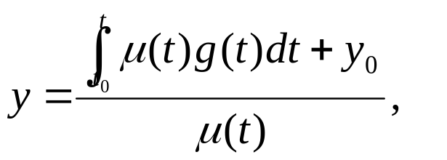
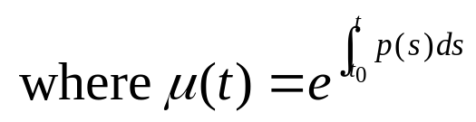
Theorem 2.4.1
Consider the linear first order initial value problem:
If the functions p and g are continuous on an open interval (α, β ) containing the point t = t₀, then there exists a unique solution y = φ(t) that satisfies the IVP for each t in (α, β ).
Proof outline: Use Ch 2.1 discussion and results:

Slide 4

Theorem 2.4.2
Consider the nonlinear first order initial value problem:
Suppose f and ∂f/∂y are continuous on some open rectangle (t, y) ∈ (α, β ) x (γ, δ ) containing the point (t₀, y₀). Then in some interval (t₀ - h, t₀ + h) ⊆ (α, β ) there exists a unique solution y = φ(t) that satisfies the IVP.
Proof discussion: Since there is no general formula for the solution of arbitrary nonlinear first order IVPs, this proof is difficult, and is beyond the scope of this course.
It turns out that conditions stated in Thm 2.4.2 are sufficient but not necessary to guarantee existence of a solution, and continuity of f ensures existence but not uniqueness of φ.

Slide 5
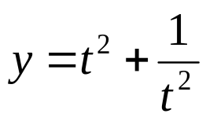

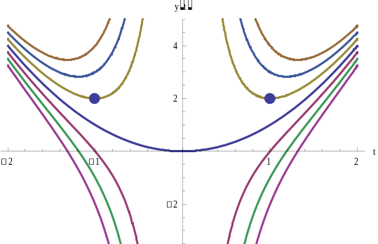
Example 1: Linear IVP
Recall the initial value problem from Chapter 2.1 slides:
The solution to this initial value problem is defined for
t > 0, the interval on which p(t) = 2/t is continuous.
If the initial condition is y(-1) = 2, then the solution is given by same expression as above, but is defined on t < 0.
In either case, Theorem 2.4.1
guarantees that solution is unique
on corresponding interval.
(-1,2)
(1,2)

Slide 6
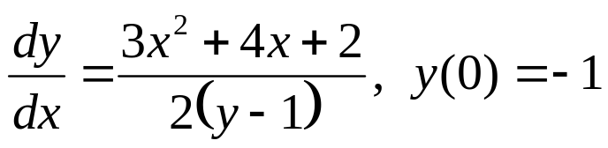
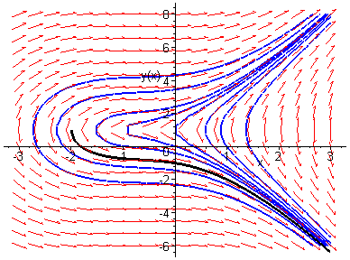
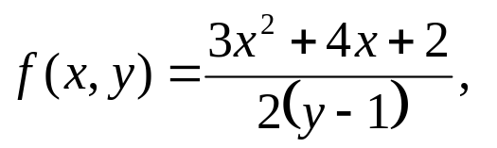
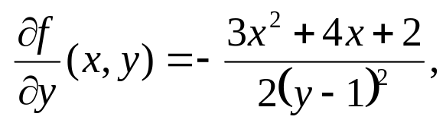

Example 2: Nonlinear IVP (1 of 2)
Consider nonlinear initial value problem from Ch 2.2:
The functions f and ∂f/∂y are given by
and are continuous except on line y = 1.
Thus we can draw an open rectangle about (0, -1) on which f and ∂f/∂y are continuous, as long as it doesn’t cover y = 1.
How wide is rectangle? Recall solution defined for t > -2, with

Slide 7
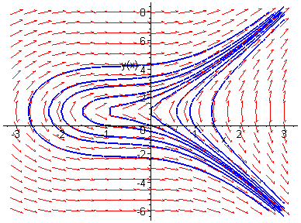

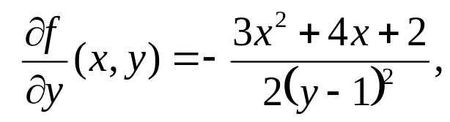
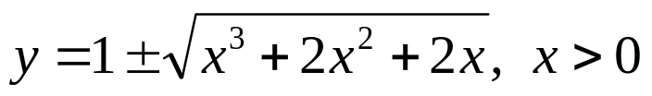
Example 2: Change Initial Condition (2 of 2)
Our nonlinear initial value problem is
with
which are continuous except on line y = 1.
If we change initial condition to y(0) = 1, then Theorem 2.4.2 is not satisfied. Solving this new IVP, we obtain
Thus a solution exists but is not unique.

Slide 8
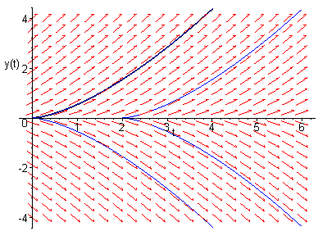

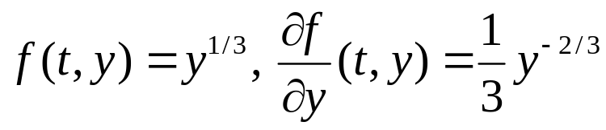
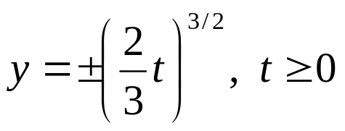
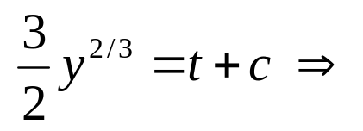

Example 3: Nonlinear IVP
Consider nonlinear initial value problem
The functions f and ∂f/∂y are given by
Thus f continuous everywhere, but ∂f/∂y doesn’t exist at y = 0, and hence Theorem 2.4.2 is not satisfied. Solutions exist but are not unique. Separating variables and solving, we obtain
If initial condition is not on t-axis, then Theorem 2.4.2 does guarantee existence and uniqueness.

Slide 9
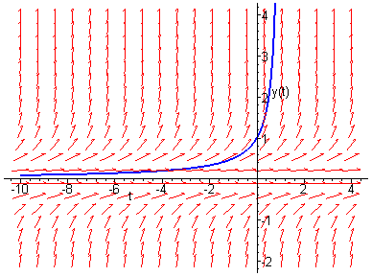

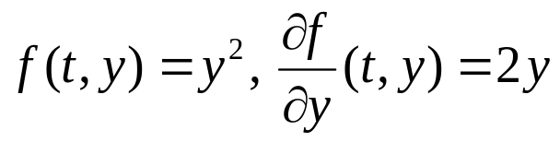
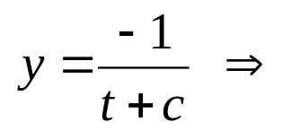
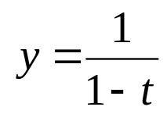


Example 4: Nonlinear IVP
Consider nonlinear initial value problem
The functions f and ∂f/∂y are given by
Thus f and ∂f/∂y are continuous at t = 0, so Thm 2.4.2 guarantees that solutions exist and are unique.
Separating variables and solving, we obtain
The solution y(t) is defined on (-∞, 1). Note that the singularity at t = 1 is not obvious from original IVP statement.

Slide 10

Interval of Definition: Linear Equations
By Theorem 2.4.1, the solution of a linear initial value problem
exists throughout any interval about t = t₀ on which p and g are continuous.
Vertical asymptotes or other discontinuities of solution can only occur at points of discontinuity of p or g.
However, solution may be differentiable at points of discontinuity of p or g. See Chapter 2.1: Example 3 of text.
Compare these comments with Example 1 and with previous linear equations in Chapter 1 and Chapter 2.

Slide 11
Interval of Definition: Nonlinear Equations
In the nonlinear case, the interval on which a solution exists may be difficult to determine.
The solution y = φ(t) exists as long as (t,φ(t)) remains within rectangular region indicated in Theorem 2.4.2. This is what determines the value of h in that theorem. Since φ(t) is usually not known, it may be impossible to determine this region.
In any case, the interval on which a solution exists may have no simple relationship to the function f in the differential equation y' = f (t, y), in contrast with linear equations.
Furthermore, any singularities in the solution may depend on the initial condition as well as the equation.
Compare these comments to the preceding examples.

Slide 12
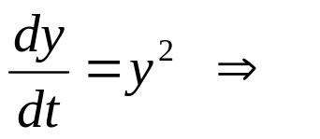
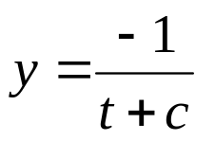
General Solutions
For a first order linear equation, it is possible to obtain a solution containing one arbitrary constant, from which all solutions follow by specifying values for this constant.
For nonlinear equations, such general solutions may not exist. That is, even though a solution containing an arbitrary constant may be found, there may be other solutions that cannot be obtained by specifying values for this constant.
Consider Example 4: The function y = 0 is a solution of the differential equation, but it cannot be obtained by specifying a value for c in solution found using separation of variables:

Slide 13
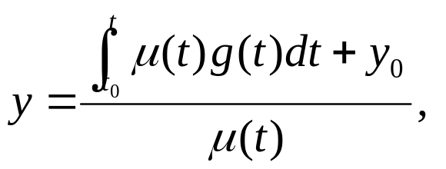
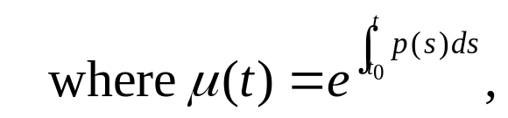
Explicit Solutions: Linear Equations
By Theorem 2.4.1, a solution of a linear initial value problem
exists throughout any interval about t = t₀ on which p and g are continuous, and this solution is unique.
The solution has an explicit representation,
and can be evaluated at any appropriate value of t, as long as the necessary integrals can be computed.

Slide 14
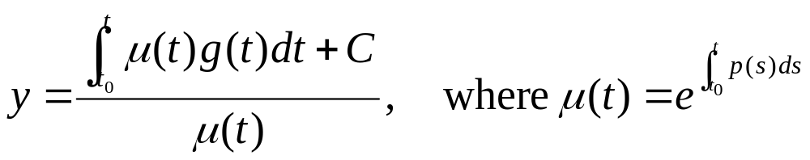
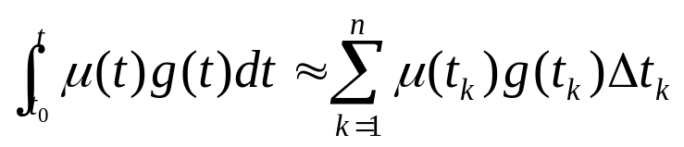
Explicit Solution Approximation
For linear first order equations, an explicit representation for the solution can be found, as long as necessary integrals can be solved.
If integrals can’t be solved, then numerical methods are often used to approximate the integrals.

Slide 15
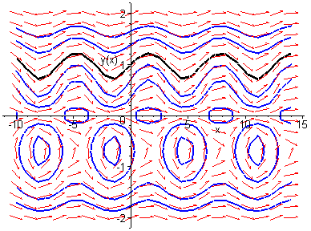
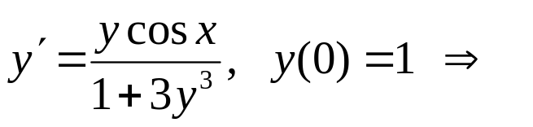

Implicit Solutions: Nonlinear Equations
For nonlinear equations, explicit representations of solutions may not exist.
As we have seen, it may be possible to obtain an equation which implicitly defines the solution. If equation is simple enough, an explicit representation can sometimes be found.
Otherwise, numerical calculations are necessary in order to determine values of y for given values of t. These values can then be plotted in a sketch of the integral curve.
Recall the examples from earlier in the
chapter and consider the following example

Slide 16
Direction Fields
In addition to using numerical methods to sketch the integral curve, the nonlinear equation itself can provide enough information to sketch a direction field.
The direction field can often show the qualitative form of solutions, and can help identify regions in the ty-plane where solutions exhibit interesting features that merit more detailed analytical or numerical investigations.
Chapter 2.7 and Chapter 8 focus on numerical methods.

